Slide 1
BRITISH AIRWAYS
PREDICTING CUSTOMER BUYING BEHAVIOUR
2022-11-09

Slide 2
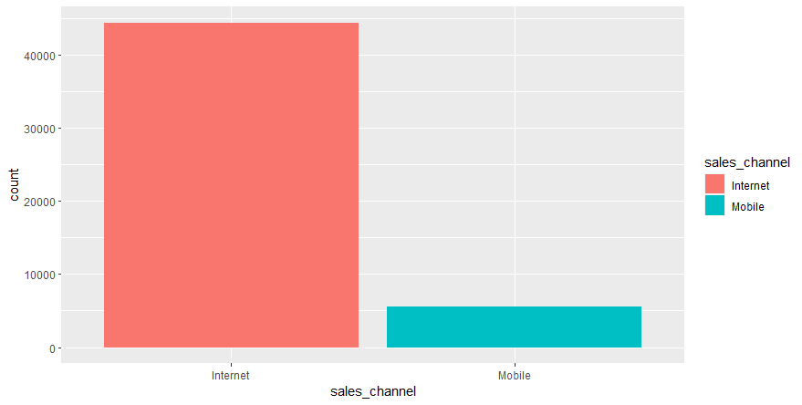
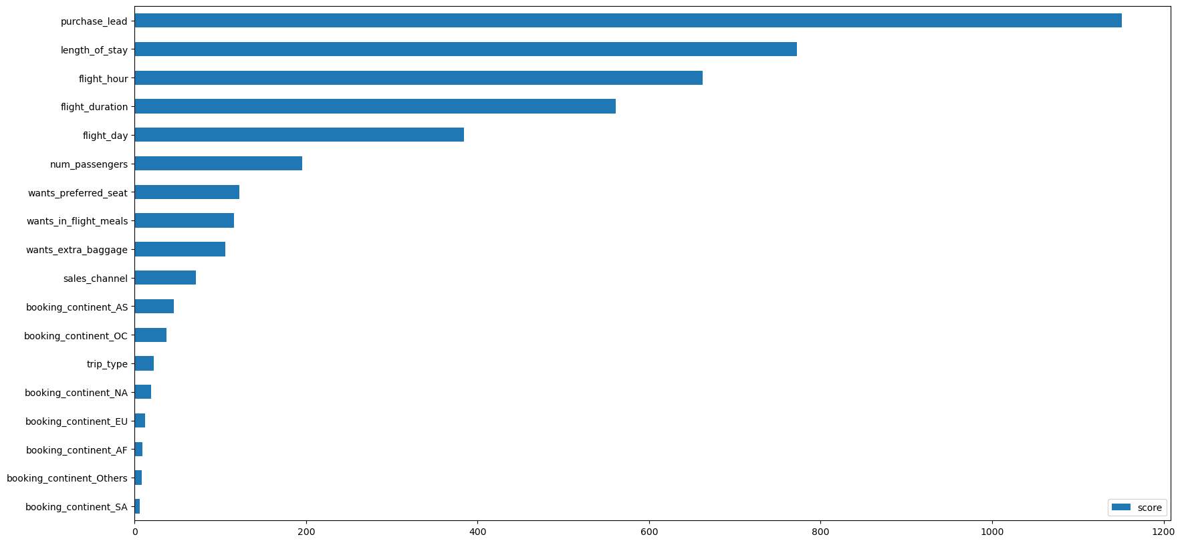
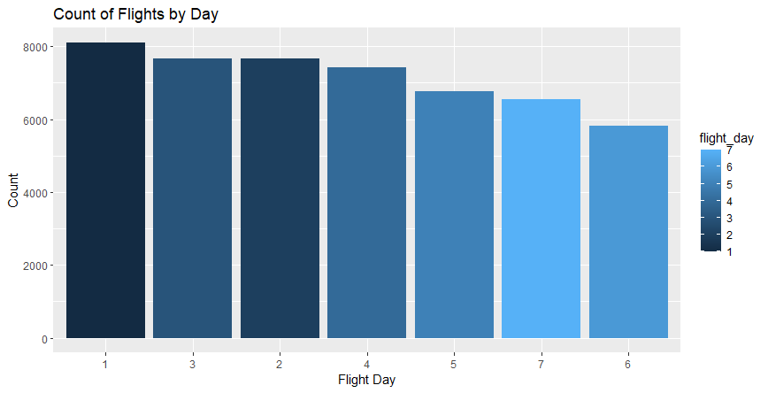
KEY INSIGHTS
Average Overall Rating
4.84 /10
About 80% of Booking Transactions are not Complete
50,000 Total customers
collected
Insights from Machine Learning:
The Use of Random Forestting Modelling to map and discover features relevant to the analysis.
From features Importance :
The most important variable in the model was purchase_lead.
booking origin and trip type was not important
Cross validating the model shows an accuracy of 80%

